Slide 1

The Machine Learning Process
How do I create a pandas DataFrame from another object?
Dr. Reza Dibaj

Slide 2
How to create a DataFrame
There are some methods to create a DF or Series and we will practice a few of them….

Slide 3
Method #01

Slide 4
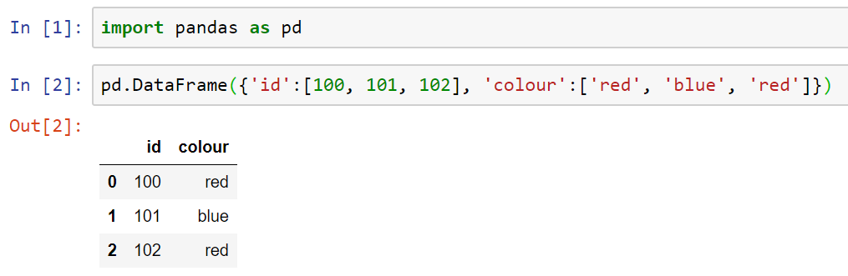
How to create a DataFrame
Using a dictionary method as follows:
The ‘Keys’ are the column headers and the values are the column values.
Notes:
import pandas as pd
pd.DataFrame({'id':[100, 101, 102], 'colour':['red', 'blue', 'red’]})

Slide 5
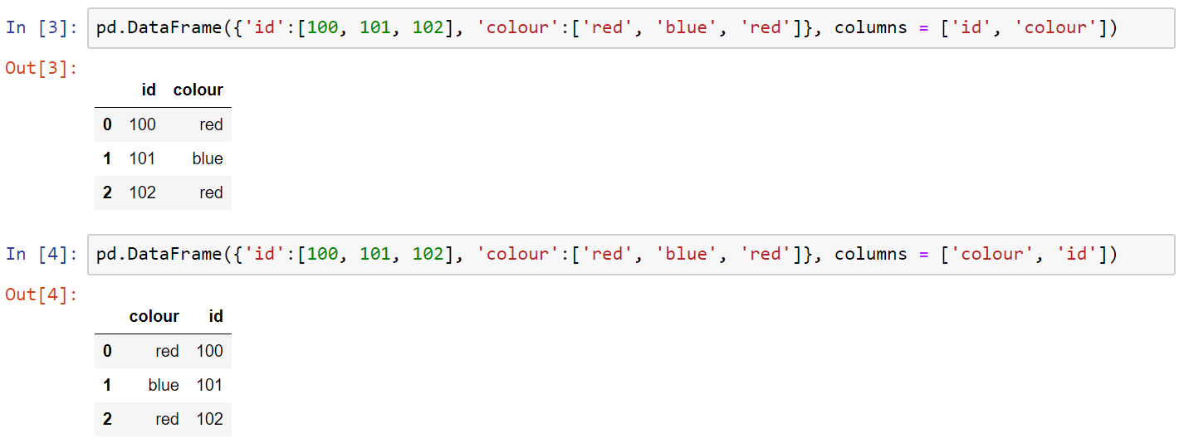
How to create a DataFrame
If you want the columns order to be specified as you want, here is what you can do….
Notes:
pd.DataFrame({'id':[100, 101, 102], 'colour':['red', 'blue', 'red']}, columns = ['id', 'colour’])
pd.DataFrame({'id':[100, 101, 102], 'colour':['red', 'blue', 'red']}, columns = ['colour', 'id'])

Slide 6
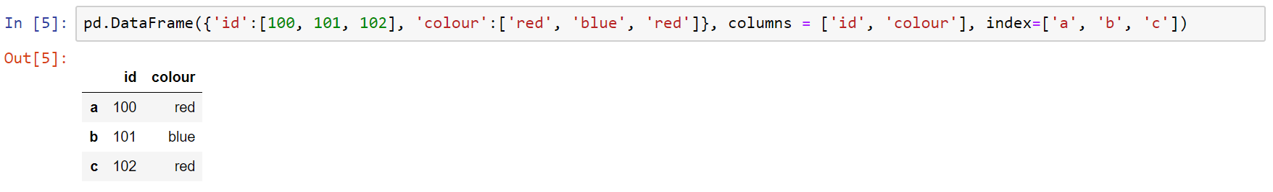
How to create a DataFrame
And if you want to use your own index, instead of the default one here is how you can do it….
Notes:
pd.DataFrame({'id':[100, 101, 102], 'colour':['red', 'blue', 'red']}, columns = ['id', 'colour'], index=['a', 'b', 'c'])

Slide 7
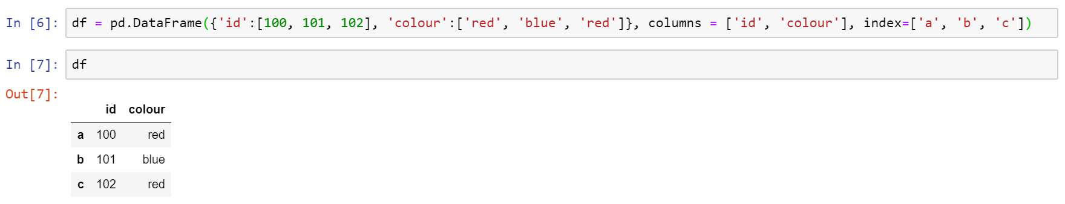
How to create a DataFrame
Here is how we save it as a DataFrame, e.g. df:
Notes:
df = pd.DataFrame({'id':[100, 101, 102], 'colour':['red', 'blue', 'red']}, columns = ['id', 'colour'], index=['a', 'b', 'c’])
df

Slide 8
Method #02

Slide 9
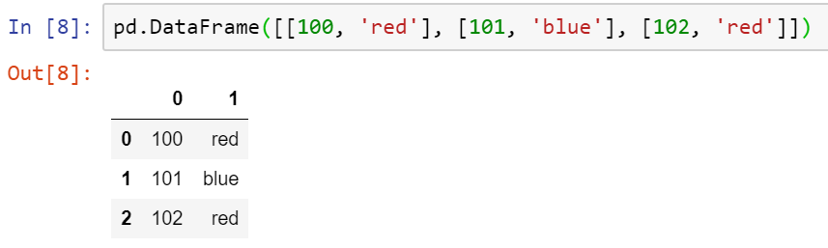
How to create a DataFrame
Creating a DataFrame in a different shape by passing a list of lists:
Each inner list treats as a row, which stack one on top of another.
Notes:
pd.DataFrame([[100, 'red'], [101, 'blue'], [102, 'red']])

Slide 10
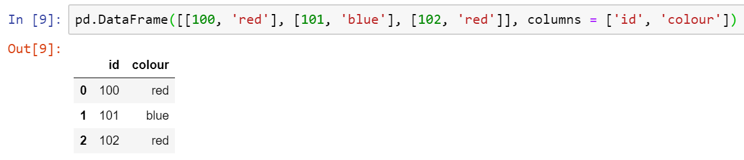
How to create a DataFrame
Let’s create column headers for them:
Notes:
pd.DataFrame([[100, 'red'], [101, 'blue'], [102, 'red']], columns = ['id', 'colour'])

Slide 11
Method #03

Slide 12
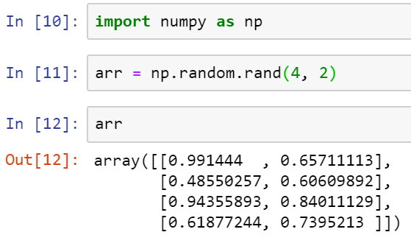
How to create a DataFrame
Sometimes we have a NumPy array and we want to convert them to a DataFrame:
Notes:
import numpy as np
arr = np.random.rand(4, 2)
arr

Slide 13
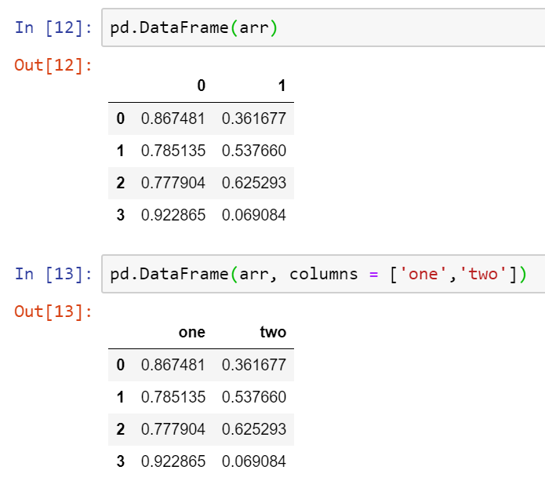
How to create a DataFrame
Let’s create a DF based on the created NumPy array:
And here is how to define column headers:
Notes:
pd.DataFrame(arr)
pd.DataFrame(arr, columns = ['one','two'])

Slide 14
Method #04

Slide 15
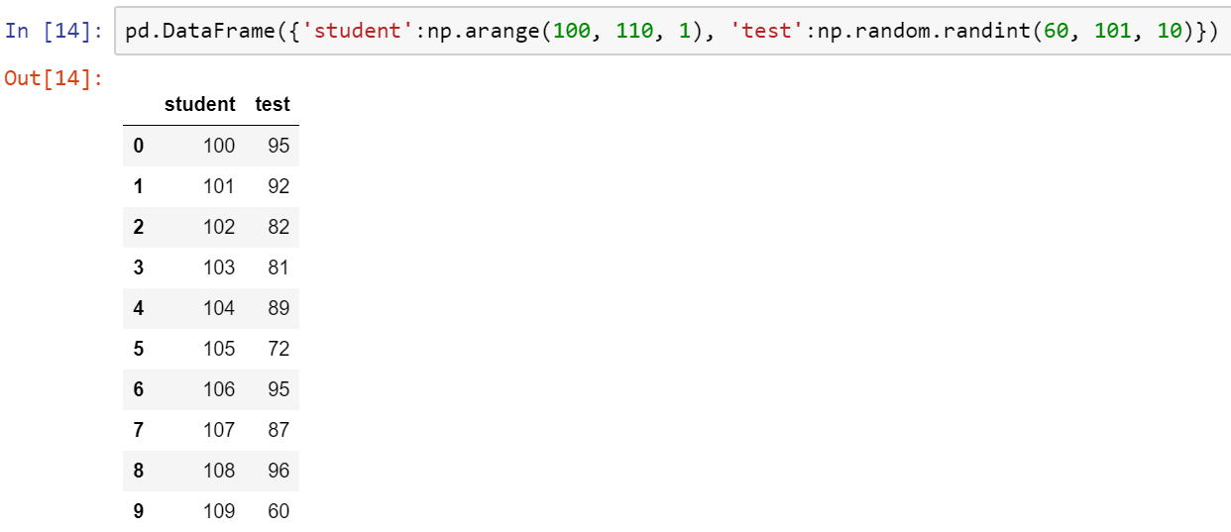
How to create a DataFrame
How to create a bigger size kind of DF?
Inclusive
Inclusive
Exclusive
Exclusive
Notes:
pd.DataFrame({'student':np.arange(100, 110, 1), 'test':np.random.randint(60, 101, 10)})

Slide 16
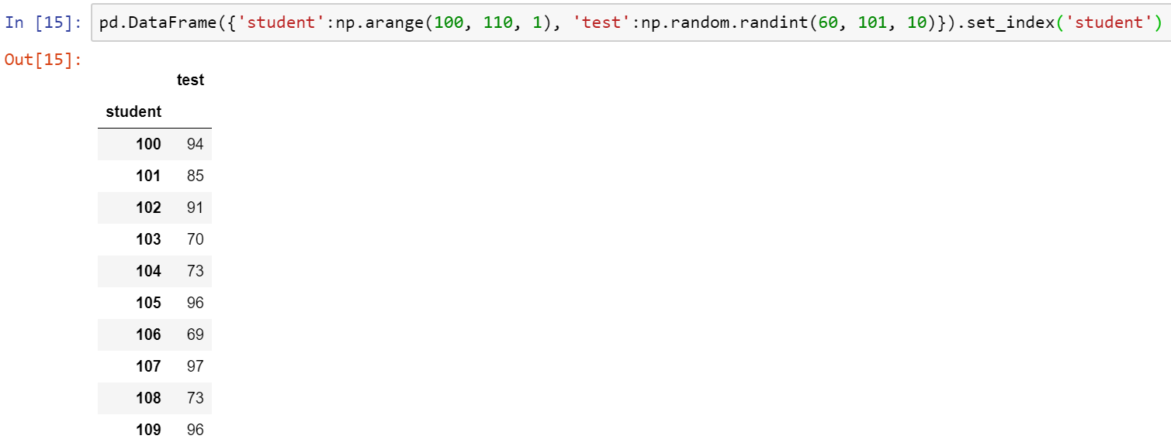
How to create a DataFrame
And here is how we set one of the columns as our index:
Notes:
pd.DataFrame({'student':np.arange(100, 110, 1), 'test':np.random.randint(60, 101, 10)}).set_index('student')

Slide 17

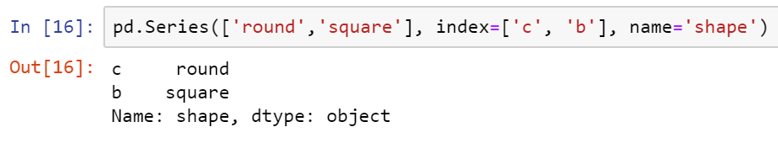
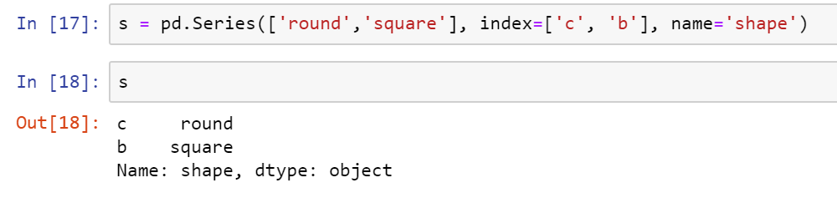
Bonus Tip
How do I create a Series and attach it to an existing DataFrame?
Let’s save this Series in a variable, called s:
Notes:
pd.Series(['round','square'], index=['c', 'b'], name='shape’)
s = pd.Series(['round','square'], index=['c', 'b'], name='shape’)
s

Slide 18
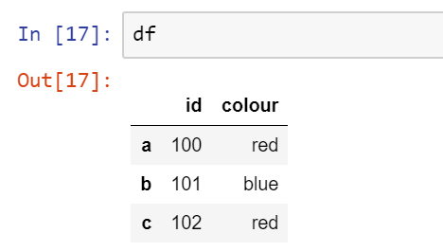
Bonus Tip
Let’s review a DF that we created at the beginning that we want to concatenate Series s with:
Notes:
df

Slide 19
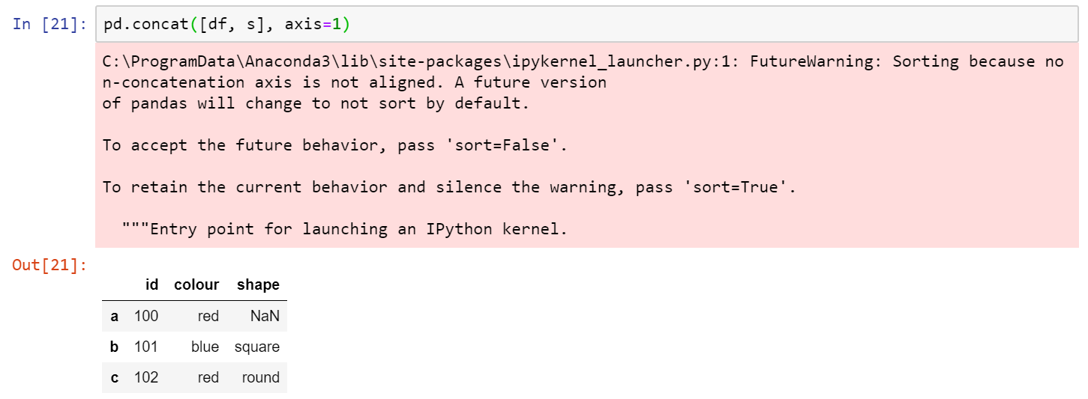
Bonus Tip
Now we use a top-level function to concatenate the DF and the Series:
Look at the index and how the Series is aligned with the DF.
Also, look at the first row and the NaN value for the shape column. What could be the reason of NaN value there?
Notes:
pd.concat([df, s], axis=1)

Slide 20
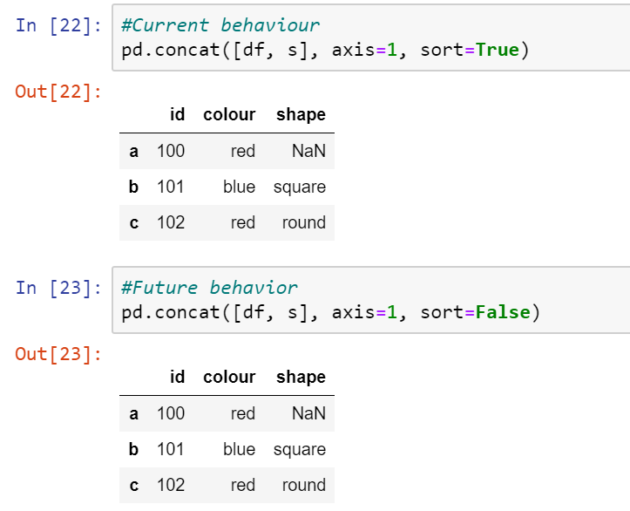
Bonus Tip
And this is how to silent the warning… Can you guess what it does?
Notes:
pd.concat([df, s], axis=1, sort=True)
pd.concat([df, s], axis=1, sort=False)

Slide 21

Thank you
Question?
To be
Not to be

